Slide 1



Plant Yearly Sales Analysis
View in Power BI
Last data refresh:
07/01/2025 19:18:35 UTC
Downloaded at:
20/01/2025 14:20:33 UTC

Slide 2
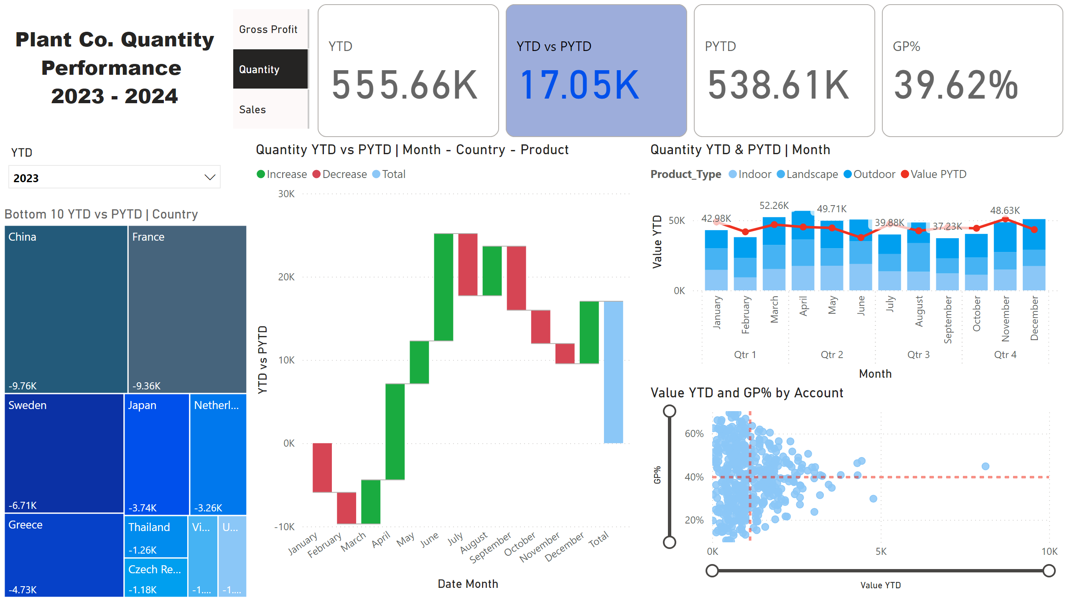
Page 1
Notes:
textbox
No alt text provided
scatterChart
No alt text provided
Quantity YTD & PYTD | Month
No alt text provided
Quantity YTD vs PYTD | Month - Country - Product
No alt text provided
Bottom 10 YTD vs PYTD | Country
No alt text provided
slicer
No alt text provided
advancedSlicerVisual
No alt text provided
cardVisual
No alt text provided

